Slide 1
Constant
Presented by Nitin Mogalapalli

Slide 2
Constant
It is an identifier whose value can not be changed at the execution time of program. In general constant can be used to represent as fixed values in a C program.

Slide 3
Constants are classified into following types.
Constant
Numeric
Integer
Real
Character
Character
String

Slide 4
Integer
Any non fractional real number is a integer
Eg: 10,15,42,91 ..etc.,

Slide 5
Real
Any fractional value is called a float.
The . (period) is used to separate the real part and fractional part in the float value.
Eg:-
-----
12.0
9.08
9.00008 ..etc
Remember that 12.0 and 12 may be equal in magnitude , but 12 is an integer and 12.0 is a float, thus computer differentiates between them.

Slide 6
Single
Any single keyboard symbol is a character
A character should always be placed with in single quotes ‘ ’
Examples:-
---------------
‘a’ ‘1’ ‘0’ ‘#’ ‘@’ ‘A’ ‘z’ …etc
Remember the following are not the same
‘8’ is a character
8 is a integer
8.0 is a float

Slide 7
String
Collection of characters is called a string
String are always enclosed between “ “ (double quotes)
Examples:-
--------------
“a”
“apple”
“this is a sentence” …etc

Slide 8
Declare constant
const keyword are used for declare a constant.
Syntax:-
const int height = 100;

Slide 9
Example
#include<stdio.h>
#include<conio.h>
void main()
{
const a=10;
printf("%d",a);
a=20; // gives error you can't modify const
getch();
}

Slide 10
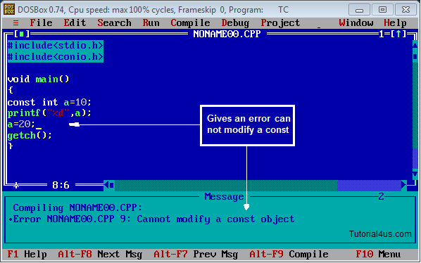
Error

